Slide 1
NLG and Argumentation
http://www.ixa.eus/iltapp/
@ragerri @joseba_fdl @iker_garciaf #iltapp
(partially based on EMNLP 2020 tutorial and Chung et al. (2019))

Slide 2
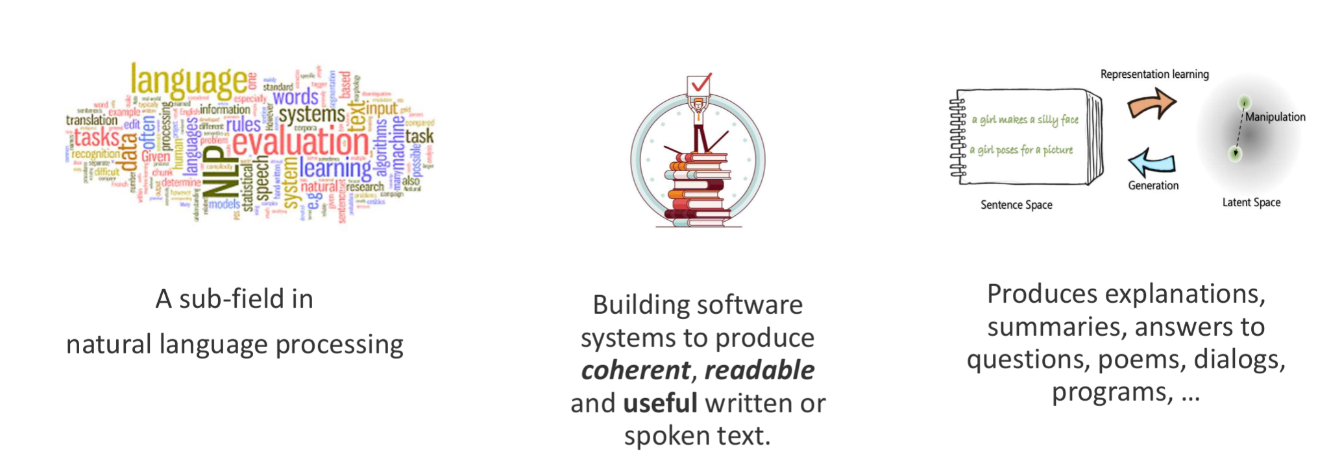
Natural Language Generation

Slide 3
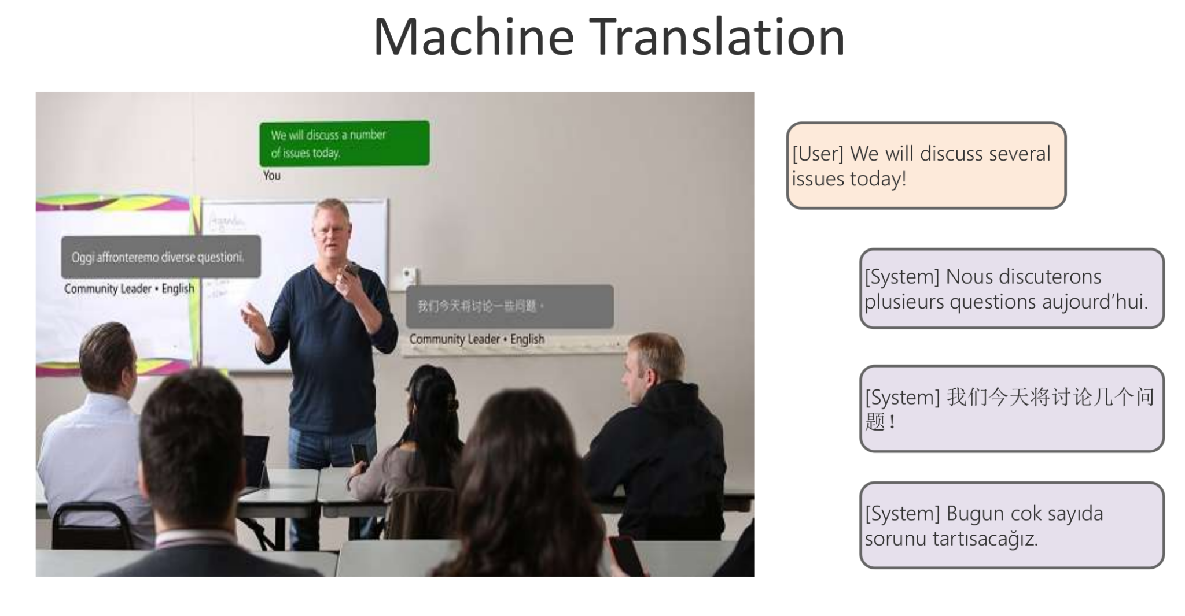

Slide 4
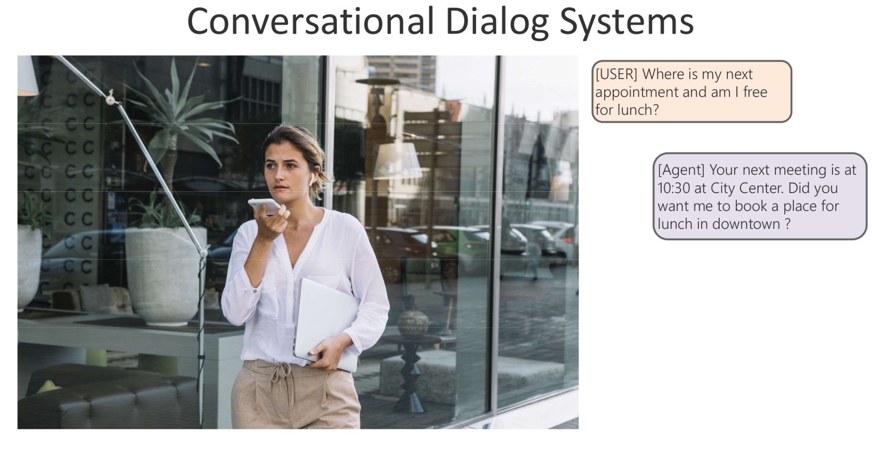

Slide 5
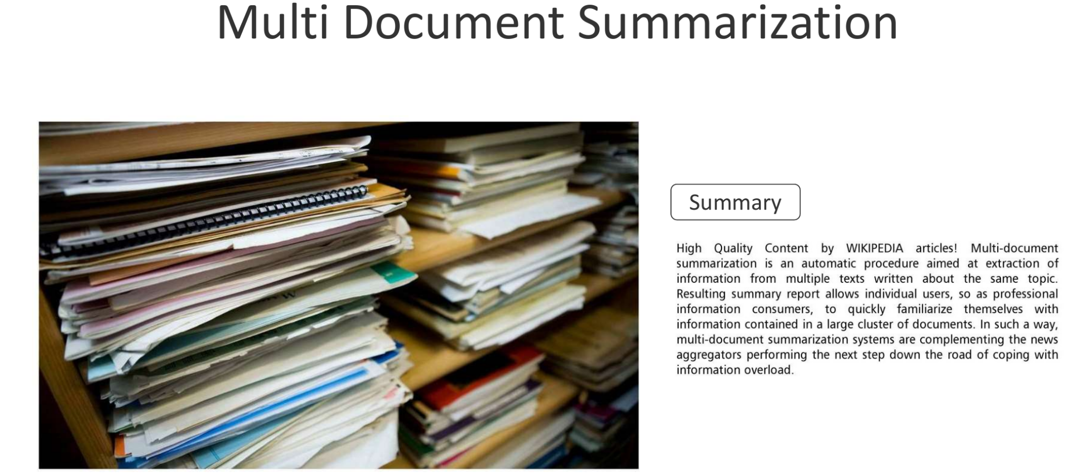

Slide 6
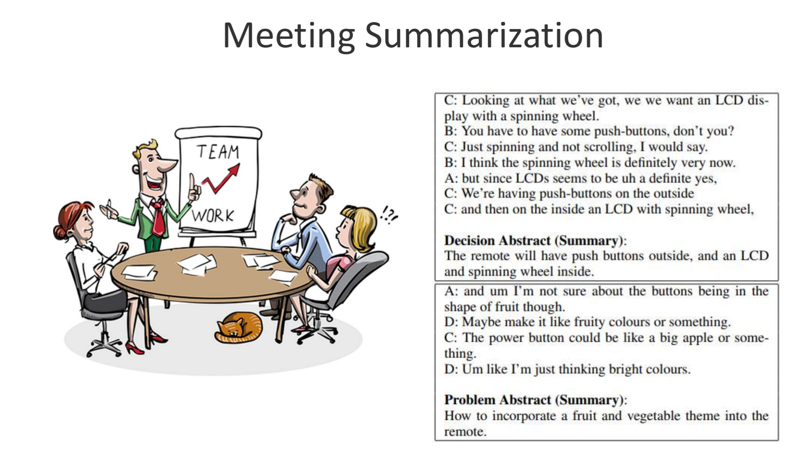

Slide 7
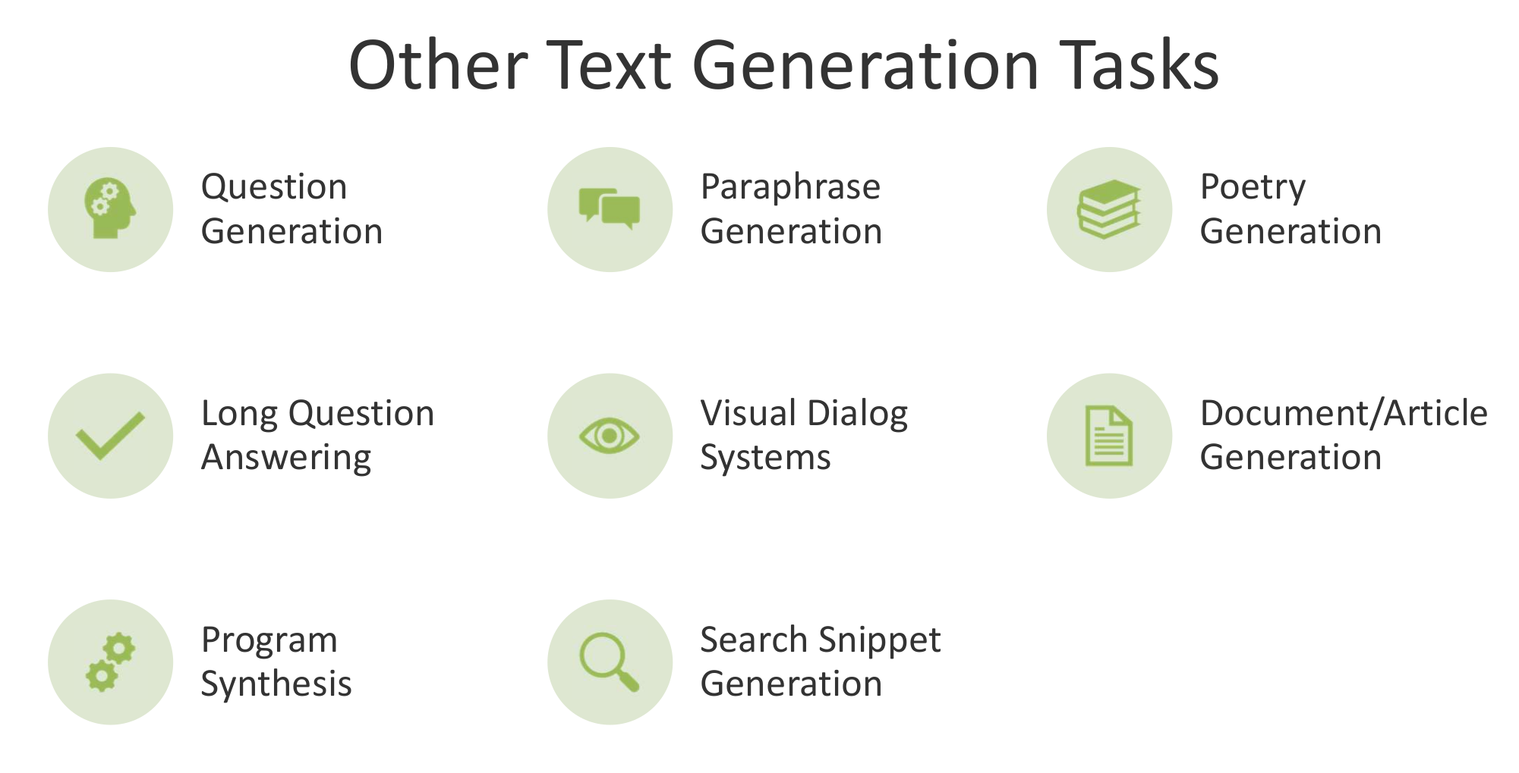

Slide 8
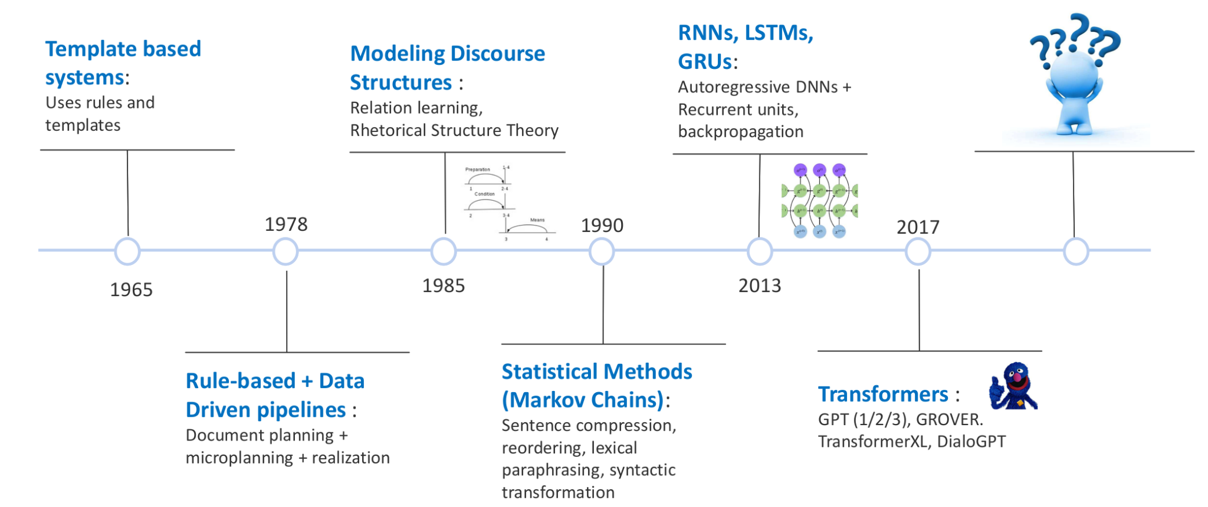

Slide 9
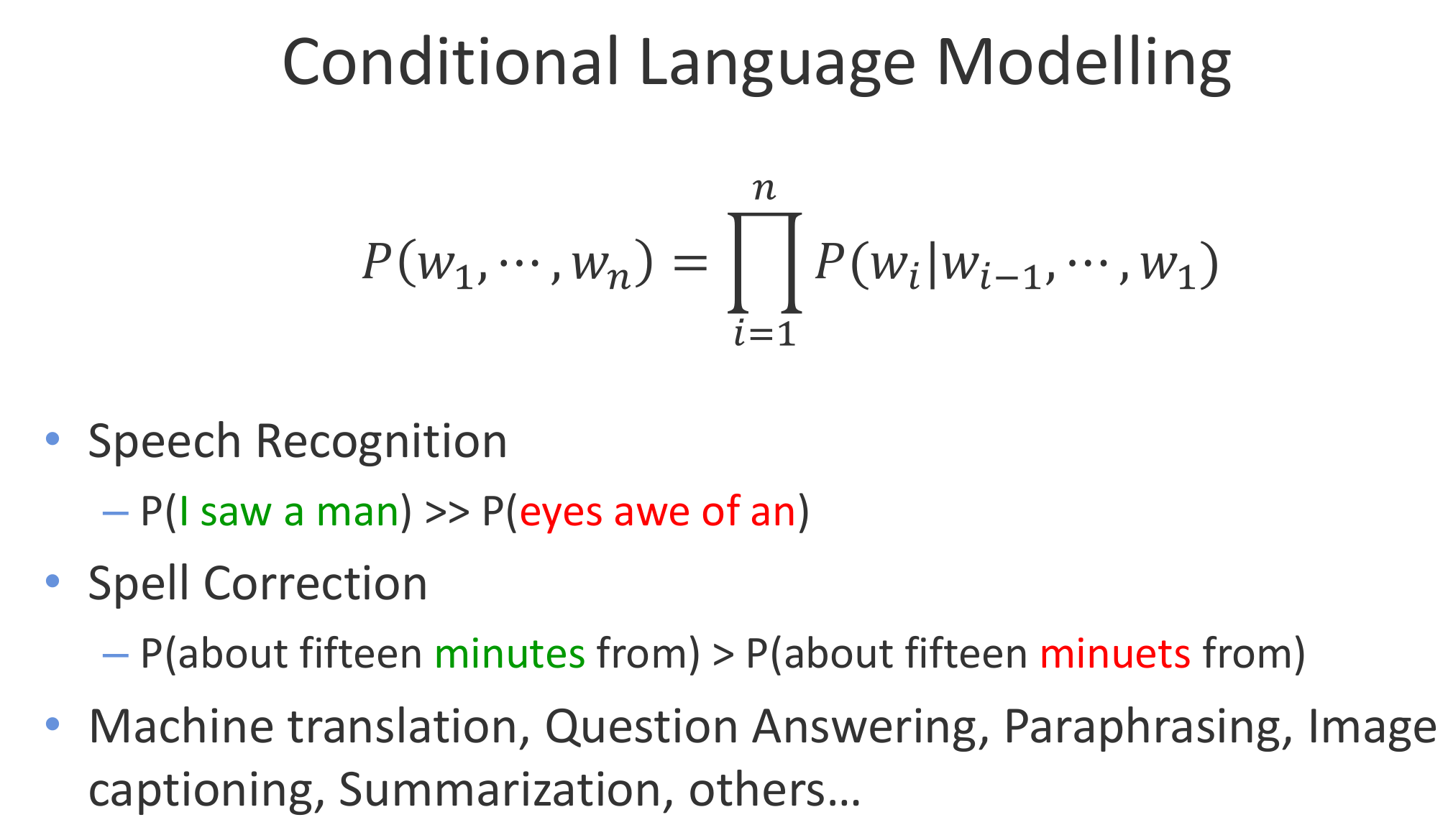

Slide 10
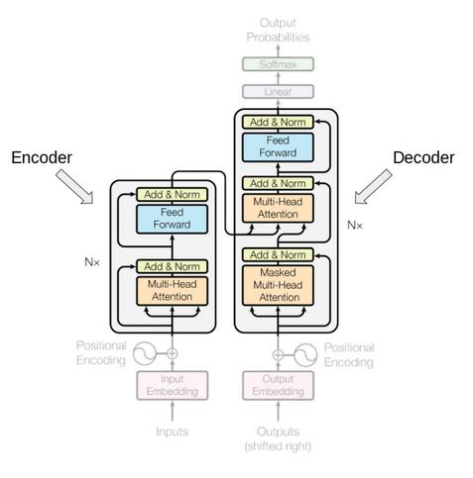
Encoder Models
Encoder of a Transformer model. At each stage, the attention layers can access all the words in the initial sentence.
The pretraining usually consists of corrupting a given sentence (for instance, by masking random words in it) and tasking the model with finding or reconstructing the initial sentence.
Best suited for tasks requiring an understanding of the full sentence, such as sentence classification, named entity recognition (and more generally word classification), and extractive question answering.

Slide 11
Decoder Models
Use only the decoder of a Transformer model.
At each stage, for a given word the attention layers can only access the words positioned before it in the sentence. These models are often called auto-regressive models.
The pretraining of decoder models usually revolves around predicting the next word in the sentence.
These models are best suited for tasks involving text generation.

Slide 12
Encoder Decoder Models
Sequence-to-sequence models use both parts of the Transformer architecture.
At each stage, the attention layers of the encoder can access all the words in the initial sentence, whereas the attention layers of the decoder can only access the words positioned before a given word in the input.
The pretraining usually involves something complex such as replacing random spans of text (that can contain several words) with a single mask special word, with the objective of predicting the text that this mask word replaces (used for T5).
Sequence-to-sequence models are best suited for tasks revolving around generating new sentences depending on a given input, such as summarization, translation, or generative question answering.

Slide 13
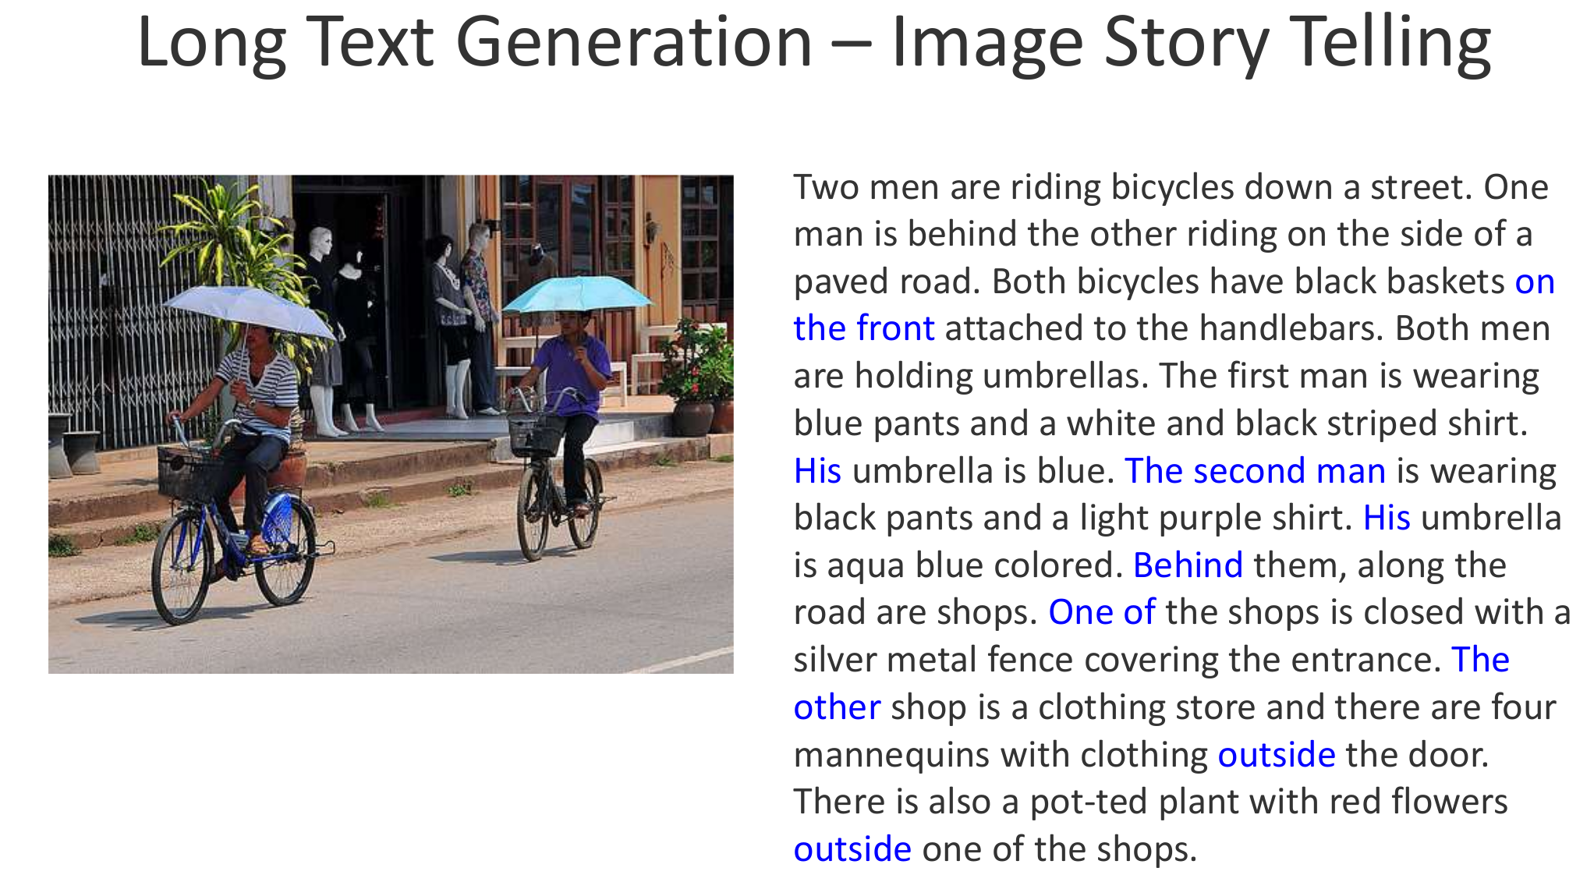

Slide 14
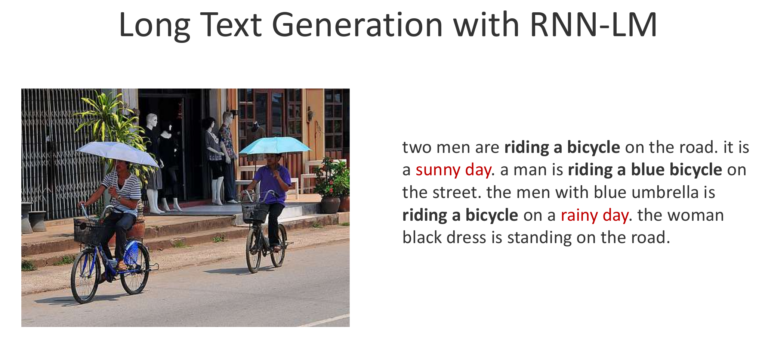

Slide 15
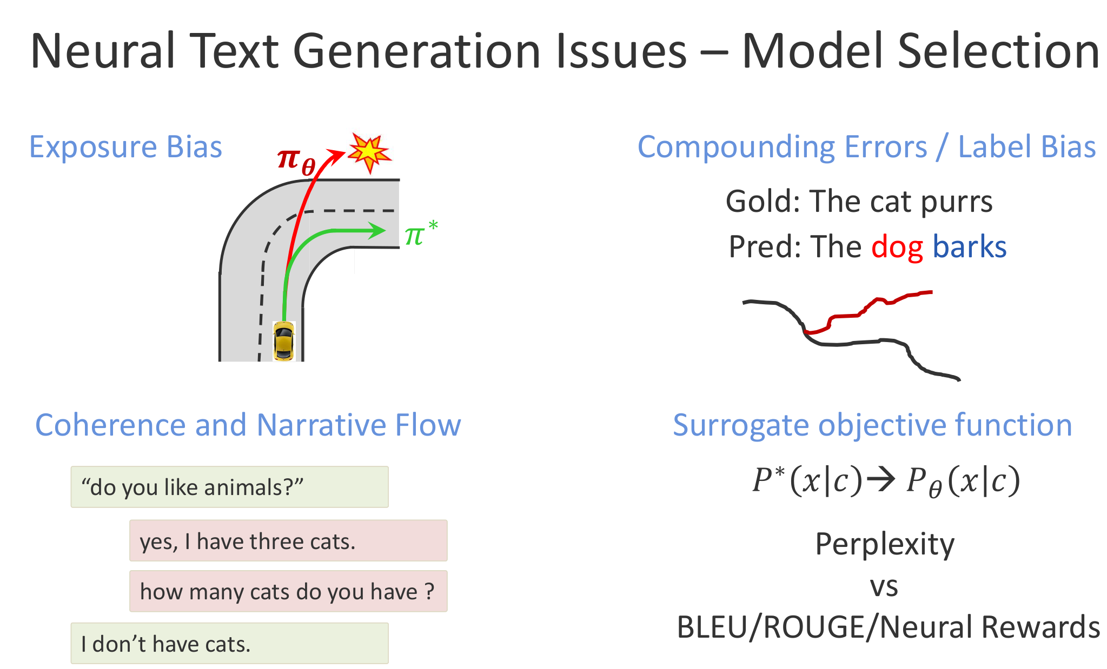

Slide 16
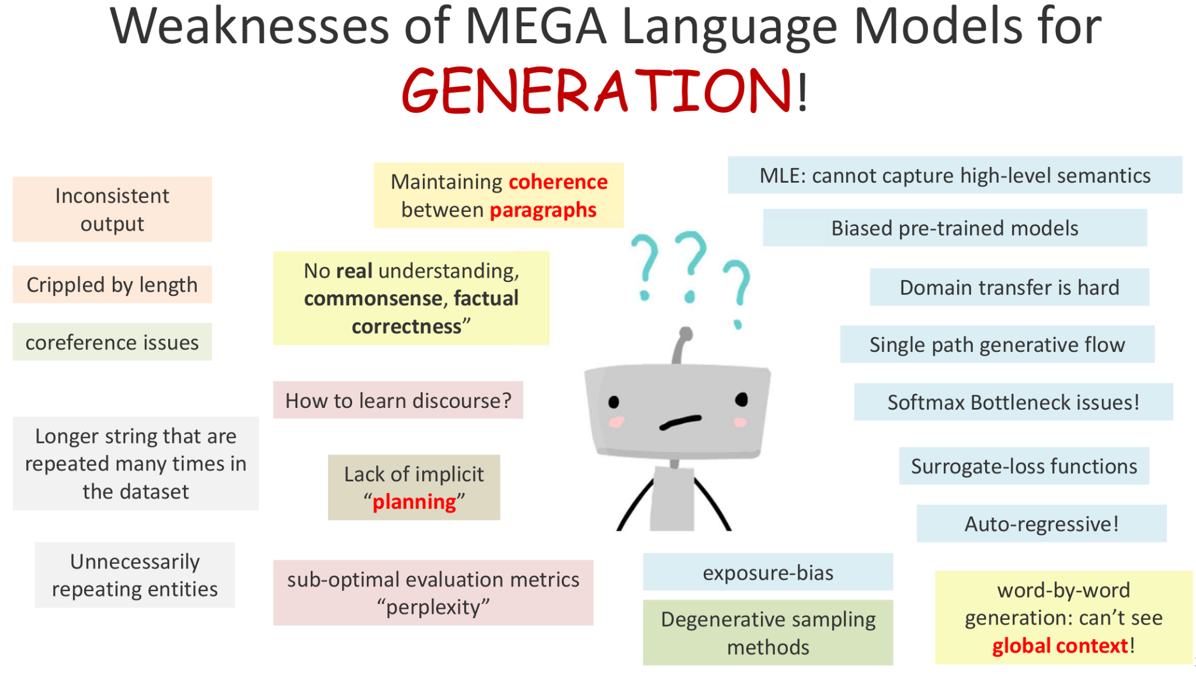

Slide 17
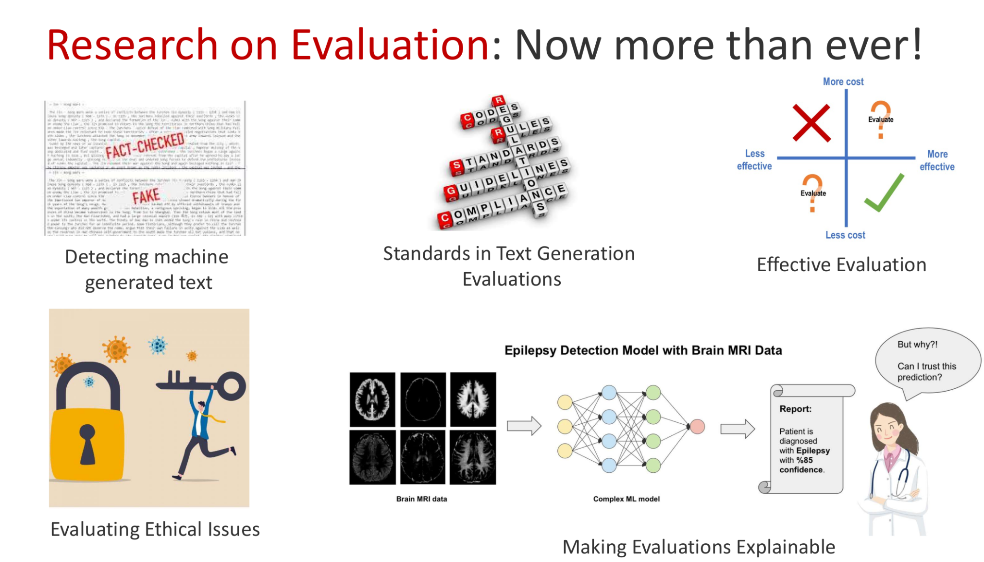

Slide 18
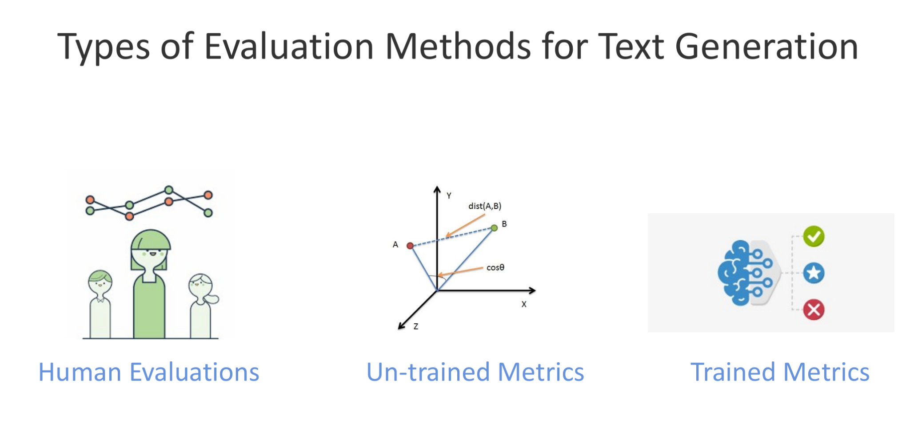

Slide 19
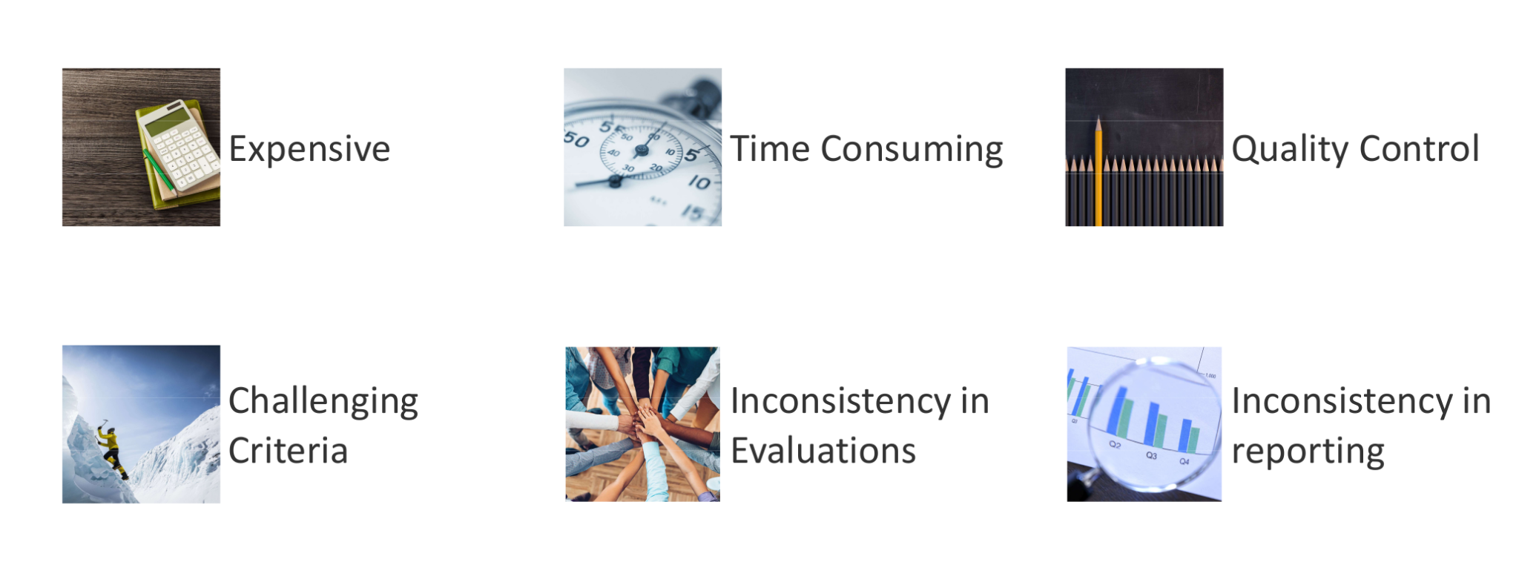
Human Evaluations - Issues

Slide 20
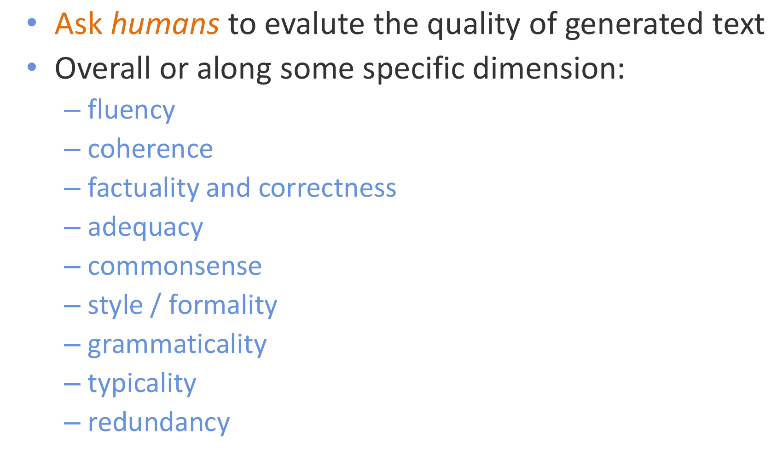
Human Evaluations - Intrinsic

Slide 21
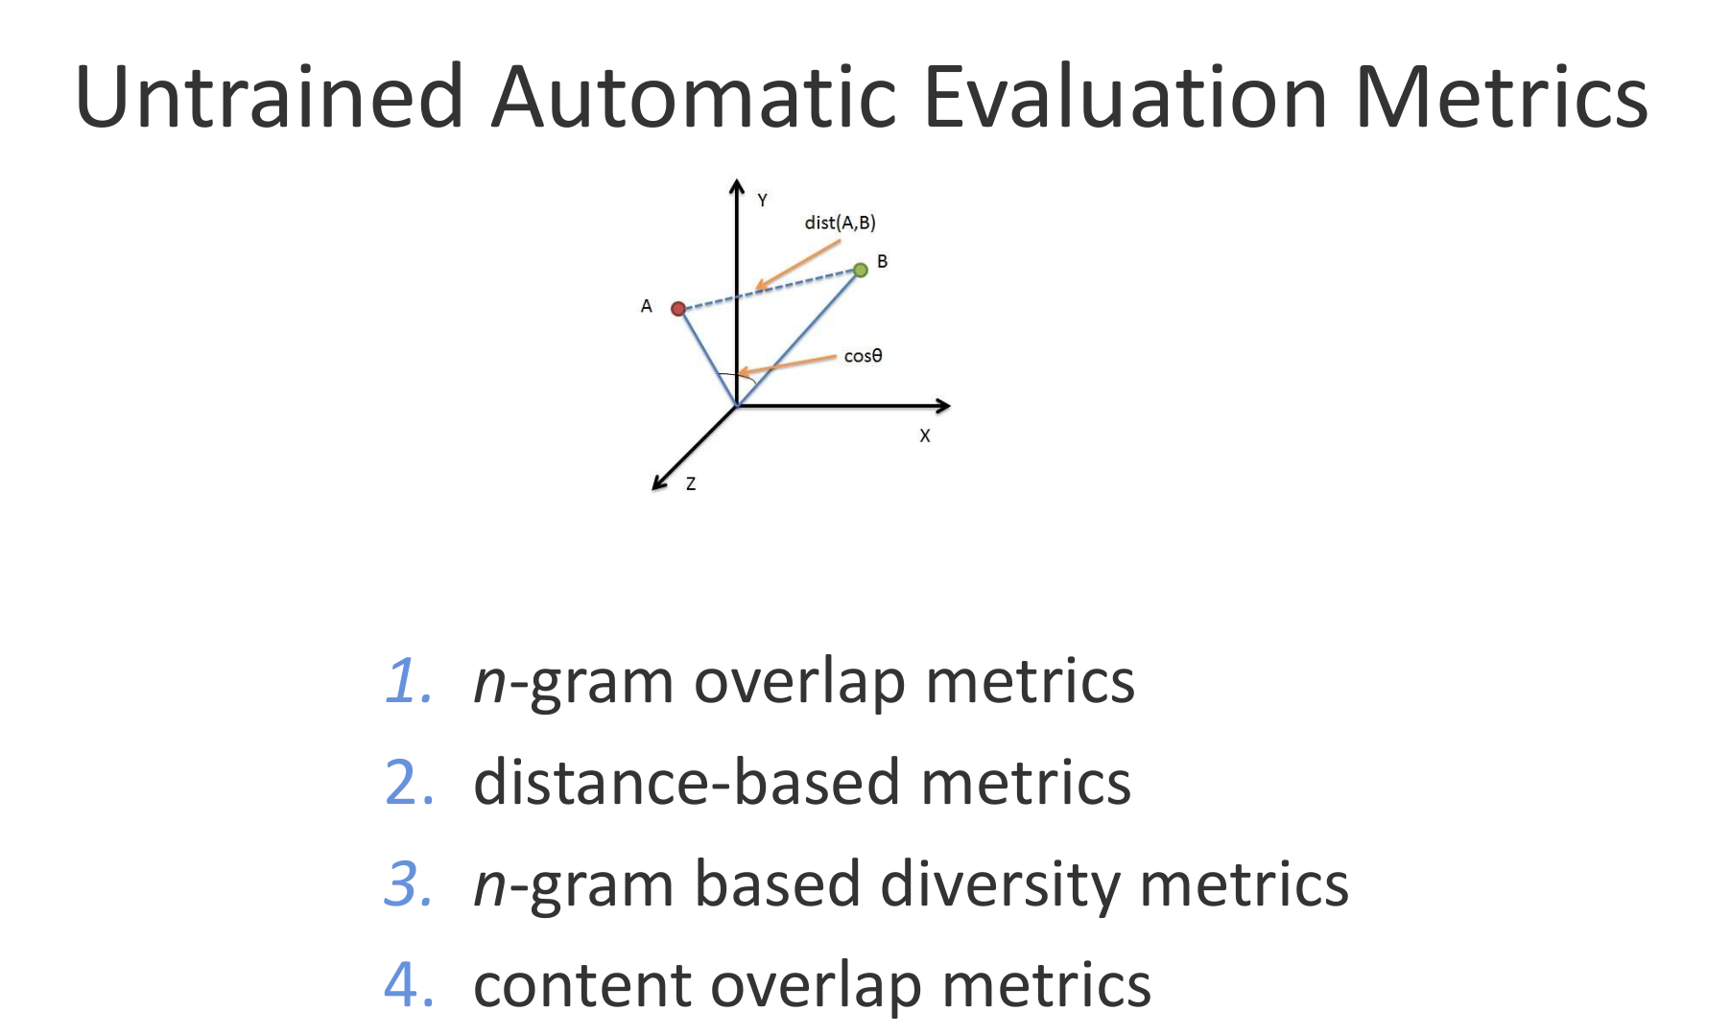

Slide 22
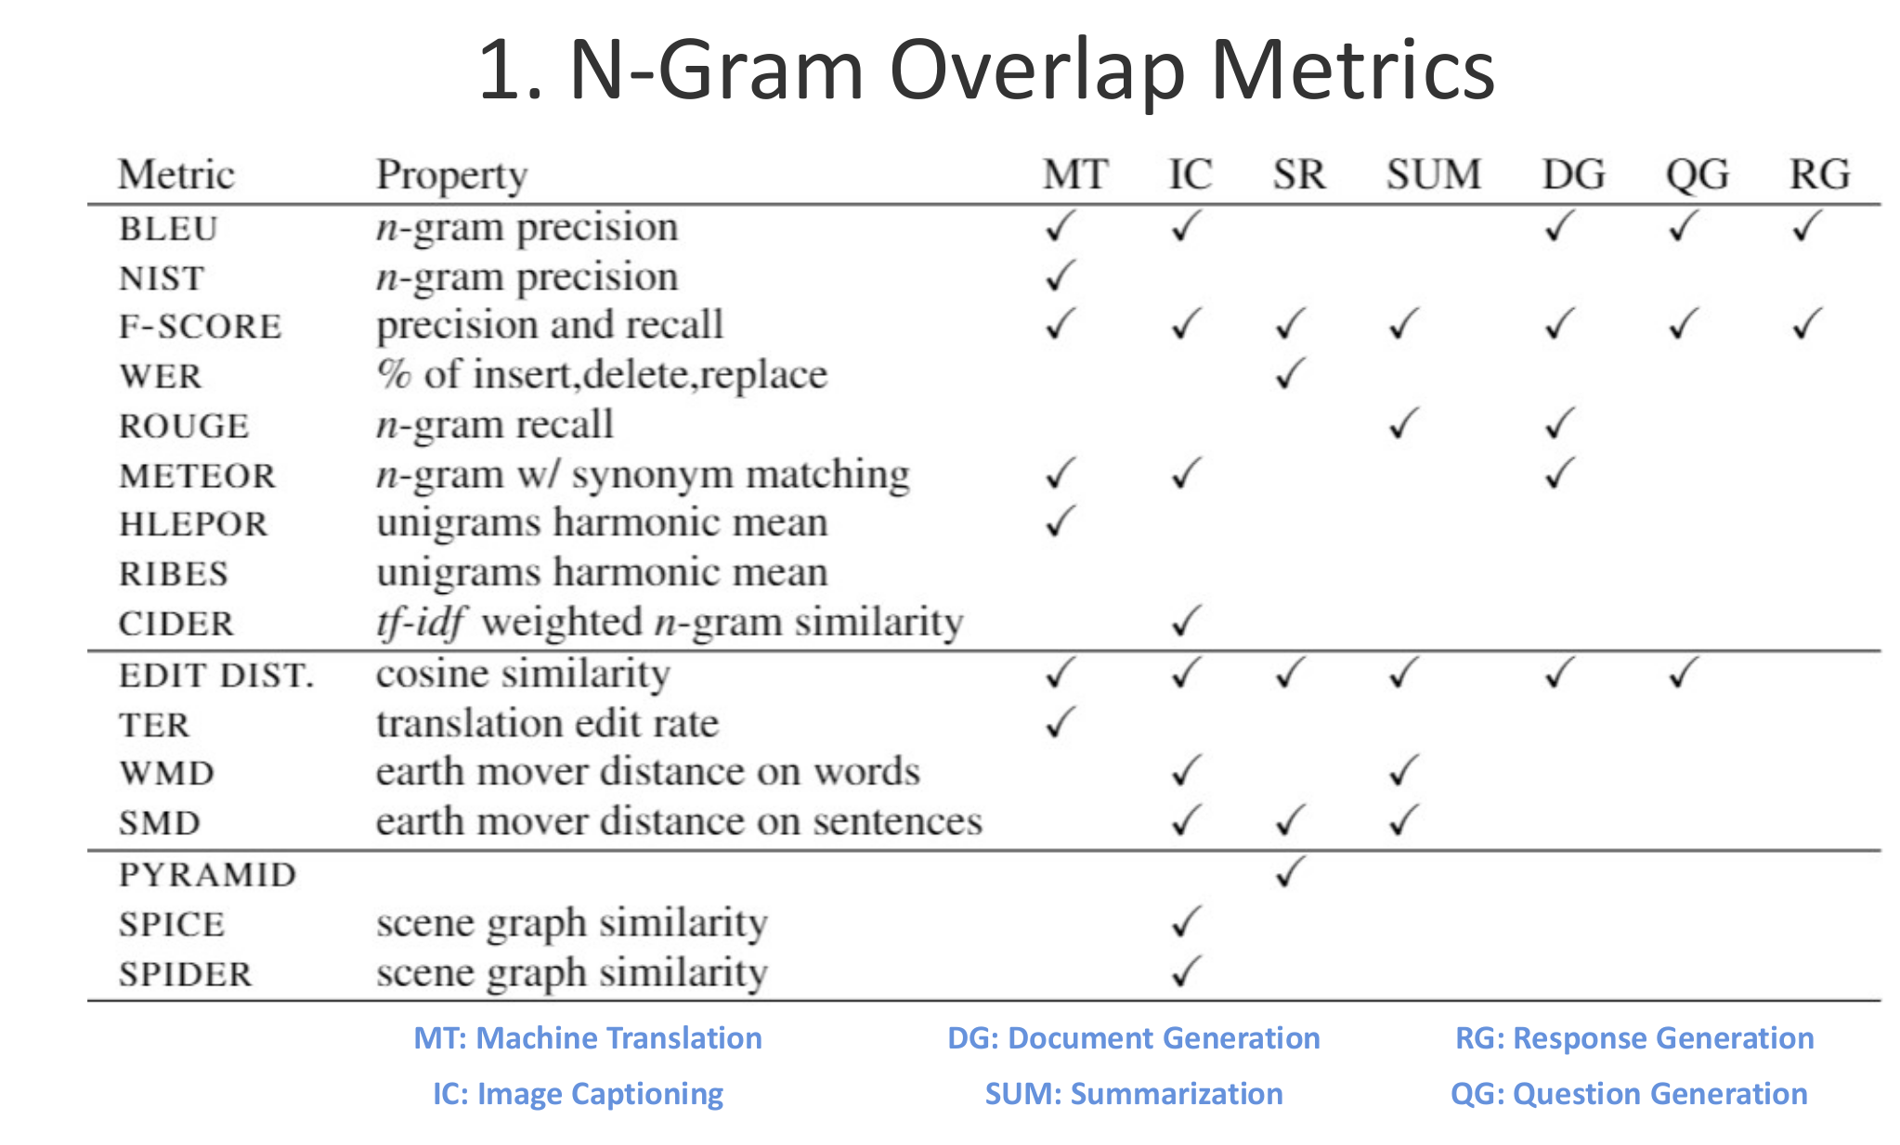

Slide 23
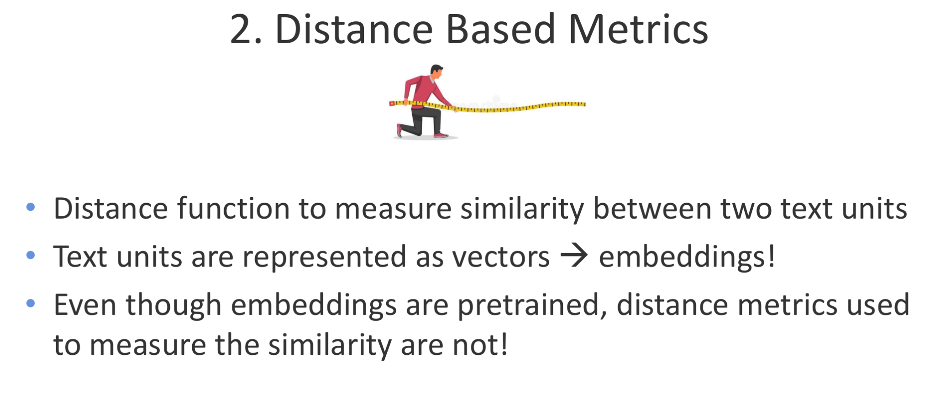

Slide 24
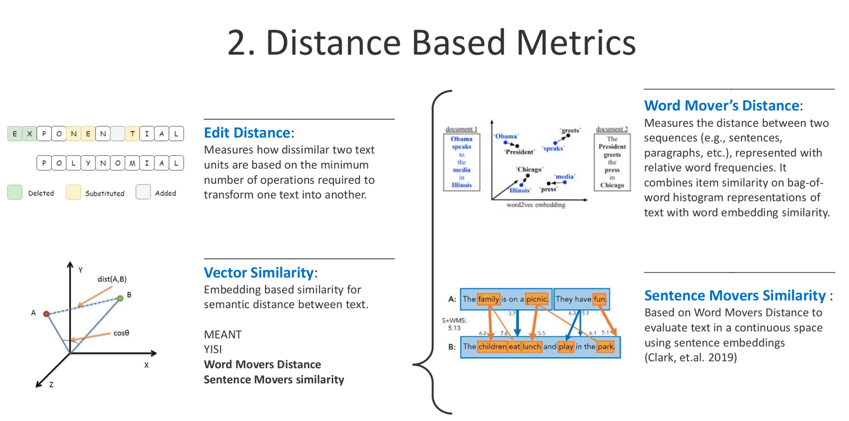

Slide 25
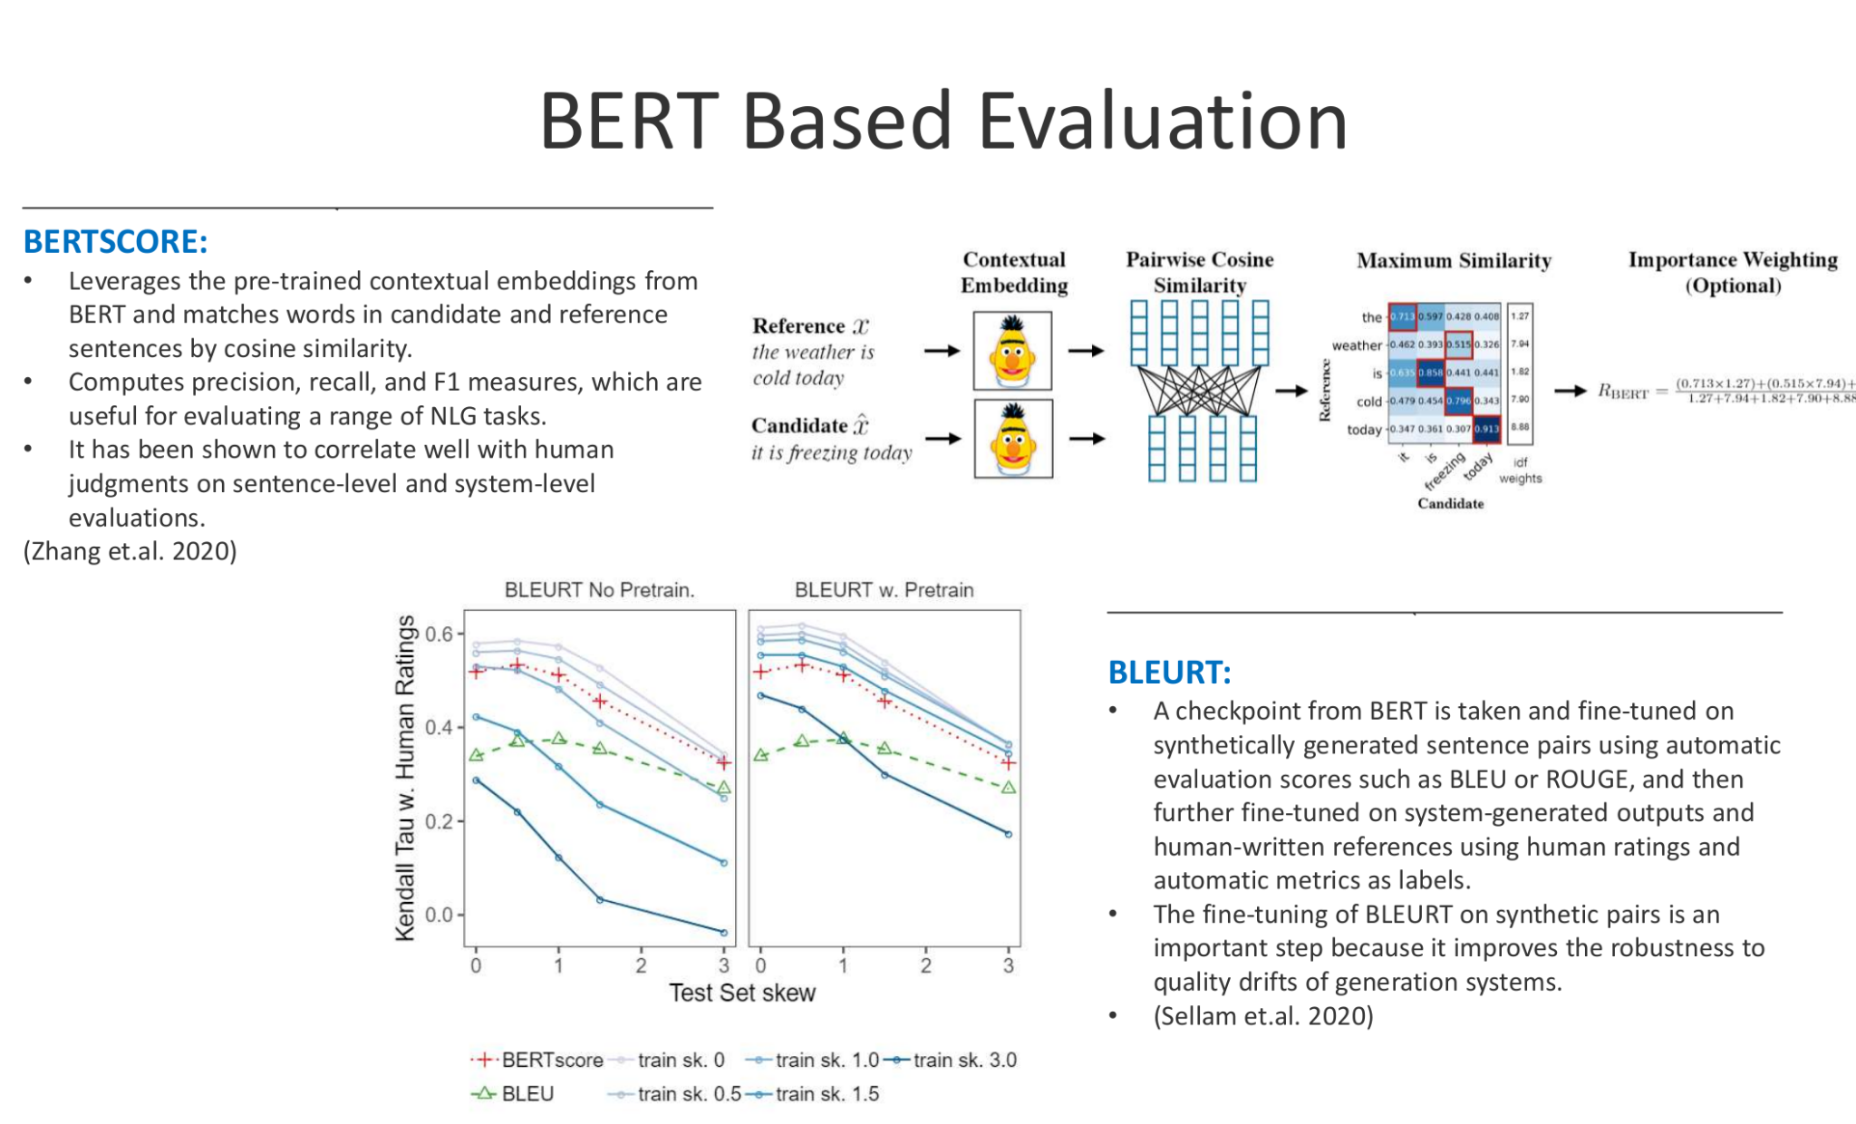

Slide 26
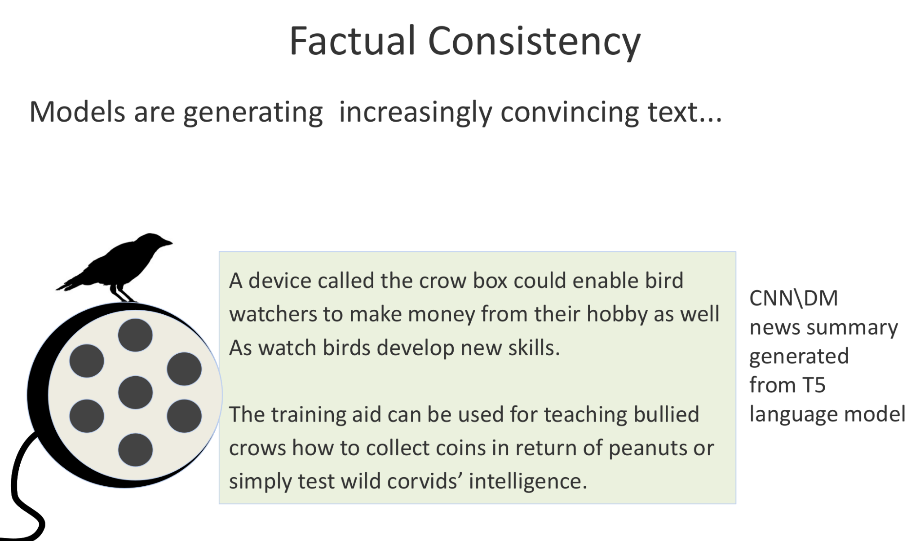

Slide 27
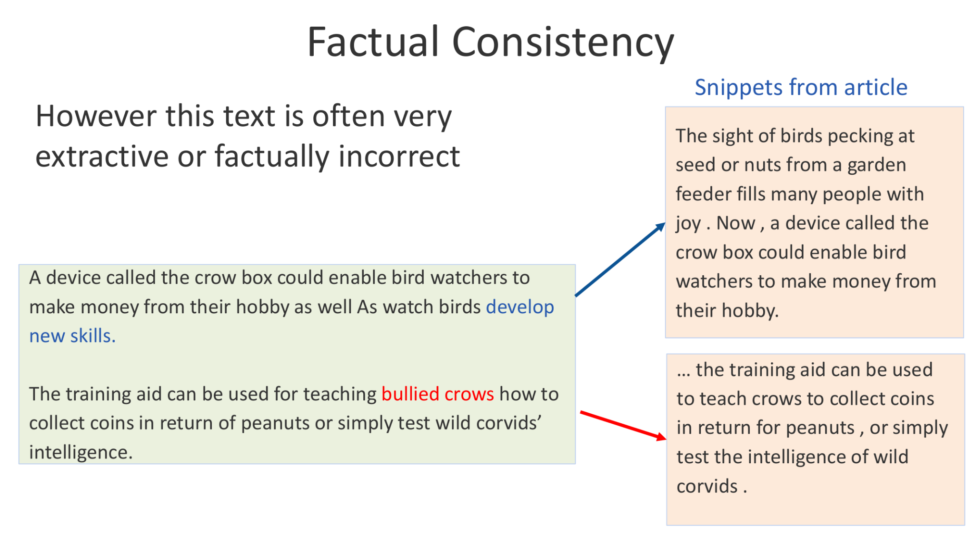

Slide 28
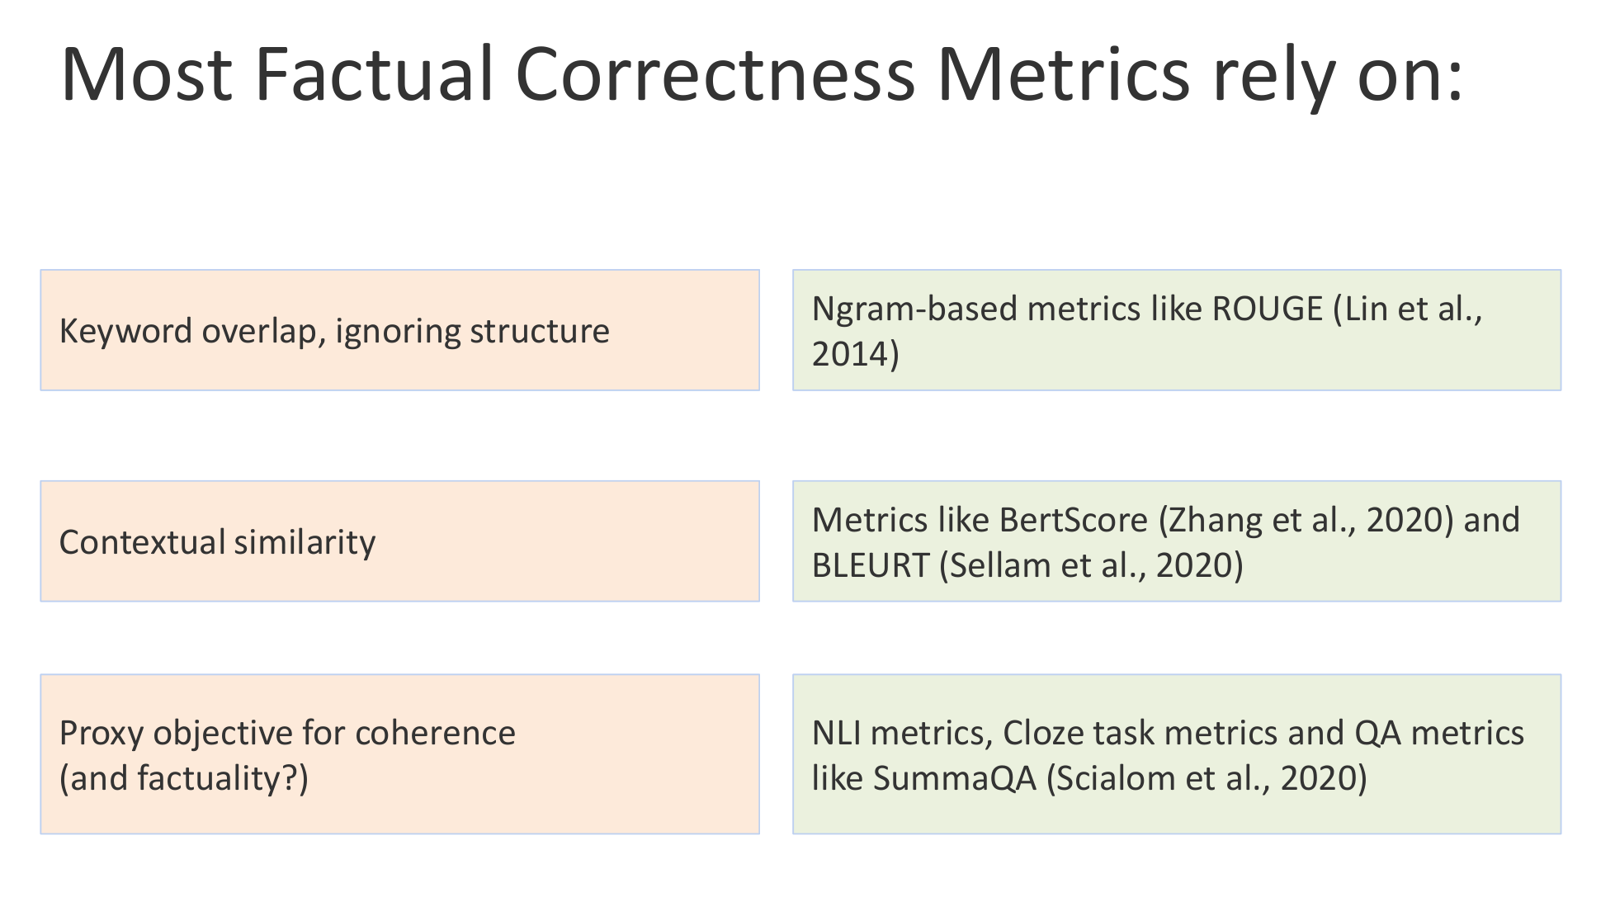

Slide 29
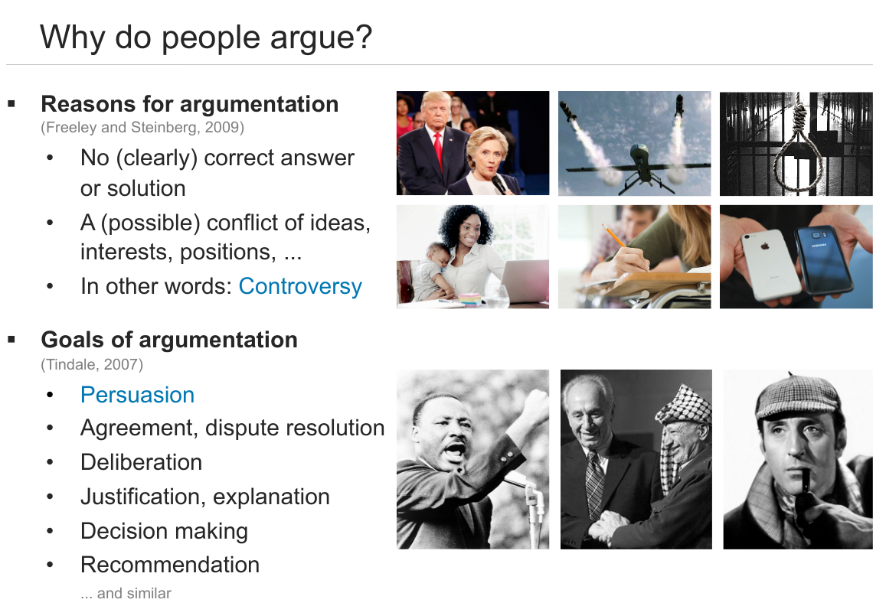

Slide 30
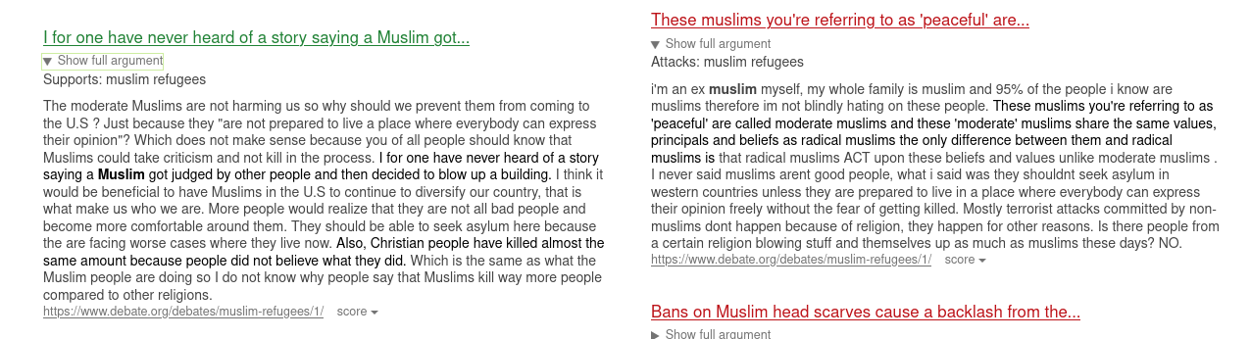
Argument Search - https://www.args.me

Slide 31
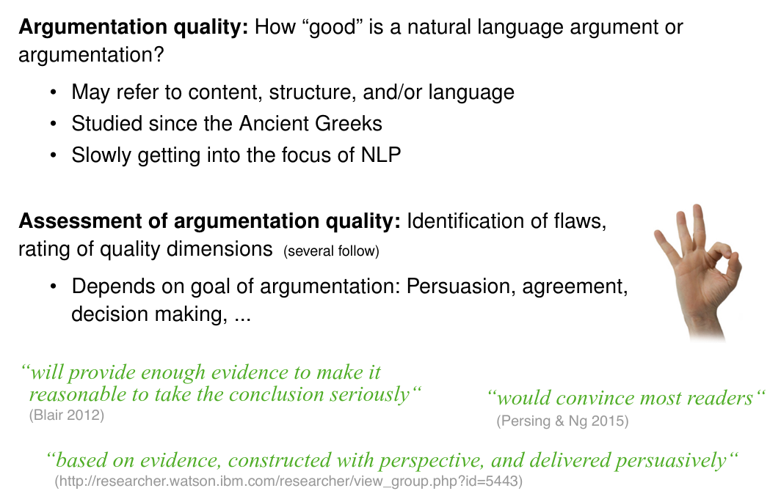
Argument Quality

Slide 32
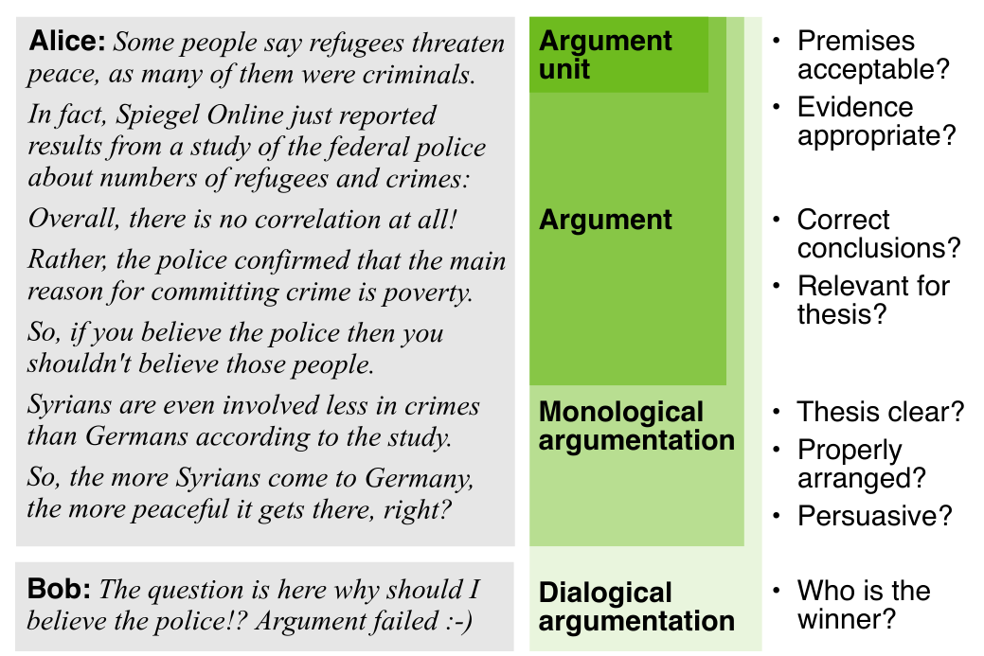
Argument Quality

Slide 33
Resource(s)
HATEMER http://hatemeter.eu/
Dataset: CONAN - Counteracting HS by Automatic generation of Counternarratives
censorship vs counternarratives: a response that provides non negative feedback through fact-bound arguments and is considered as the most effective approach to withstand hate speech.
counternarratives:
preserve the right to freedom of speech,
counter stereotypes and mis-leading information with credible evidence.
It may also alter the viewpoints of haters and bystanders, by encouraging the exchange of opinions and mutual understanding.
It may help de-escalating the conversation.
Original English version: translated into Italian and French.
New data in Basque and Spanish (the data you are using for the lab).
DISCLAIMER: We do NOT CONDONE any form of hate speech

Slide 34
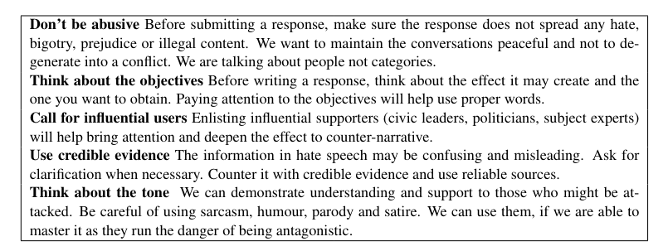
CONAN - NGO guidelines

Slide 35
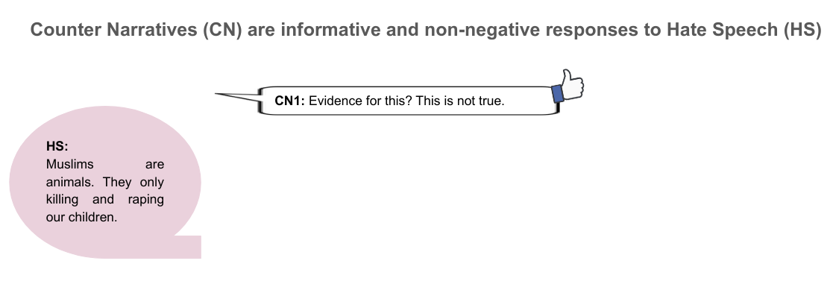
Generating counternarratives to fight hate speech
Warning: these slides contains content that may be offensive or upsetting

Slide 36
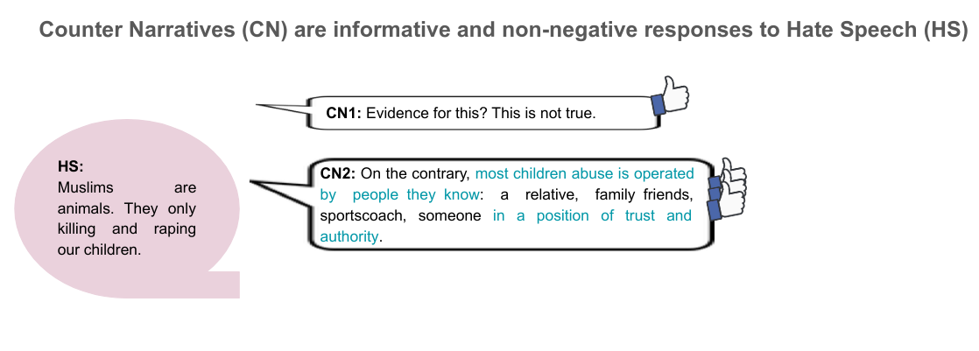
Generating counternarratives to fight hate speech
Warning: these slides contains content that may be offensive or upsetting

Slide 37
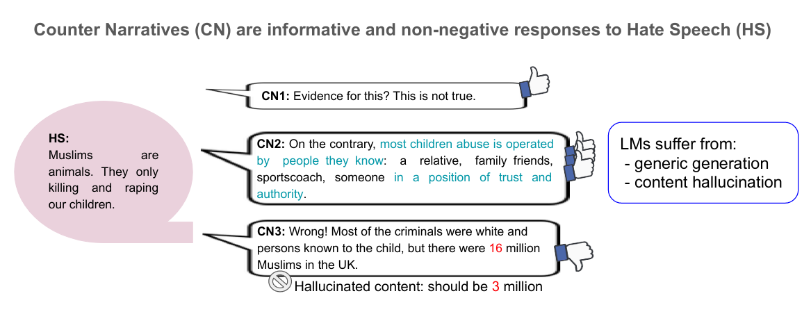
Generating counternarratives to fight hate speech
Warning: these slides contains content that may be offensive or upsetting

Slide 38
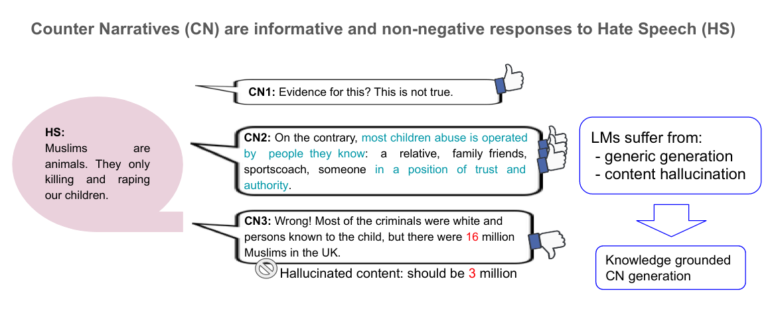
Generating counternarratives to fight hate speech
Warning: these slides contains content that may be offensive or upsetting

Slide 39
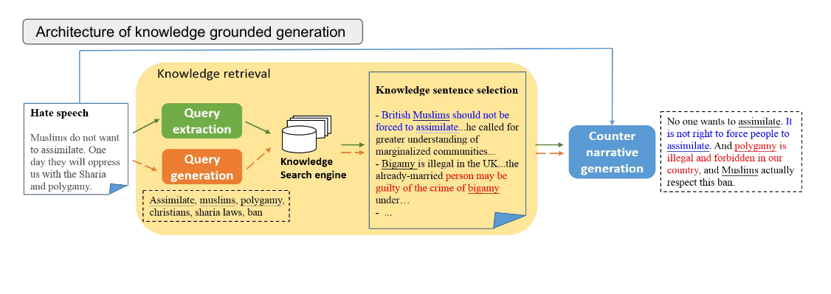
Generating counternarratives to fight hate speech
Warning: these slides contains content that may be offensive or upsetting

Slide 40
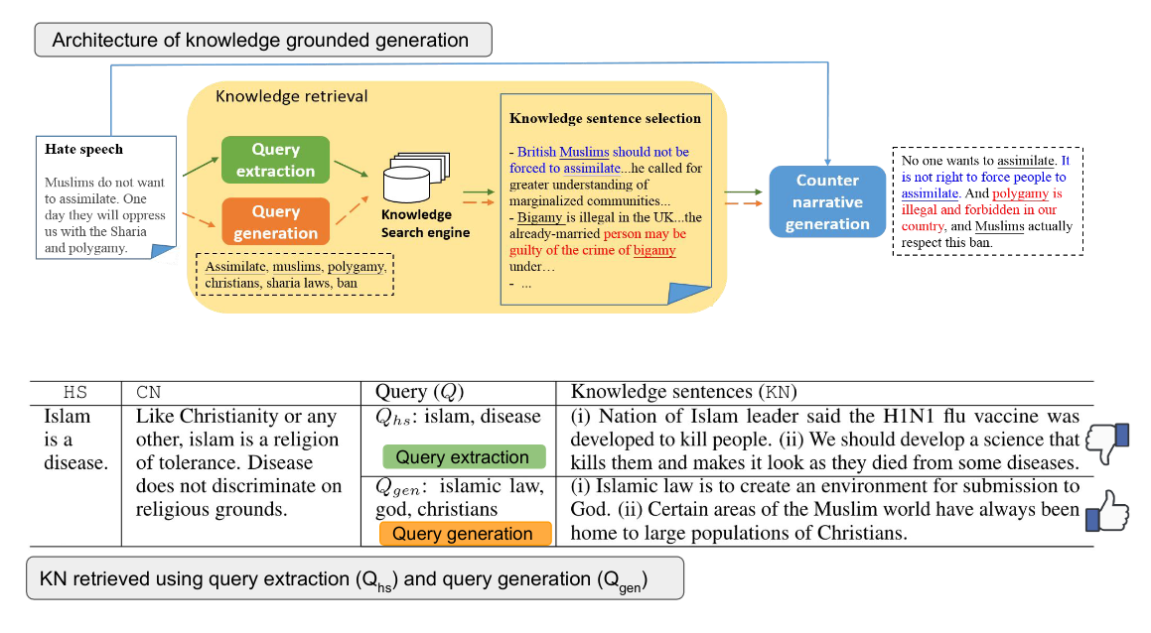
Generating counternarratives to fight hate speech
Warning: these slides contains content that may be offensive or upsetting

Slide 41
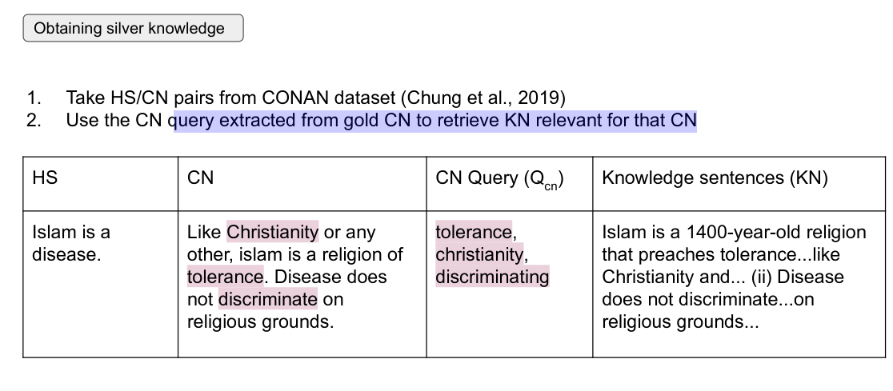
Generating counternarratives to fight hate speech
Warning: these slides contains content that may be offensive or upsetting

Slide 42
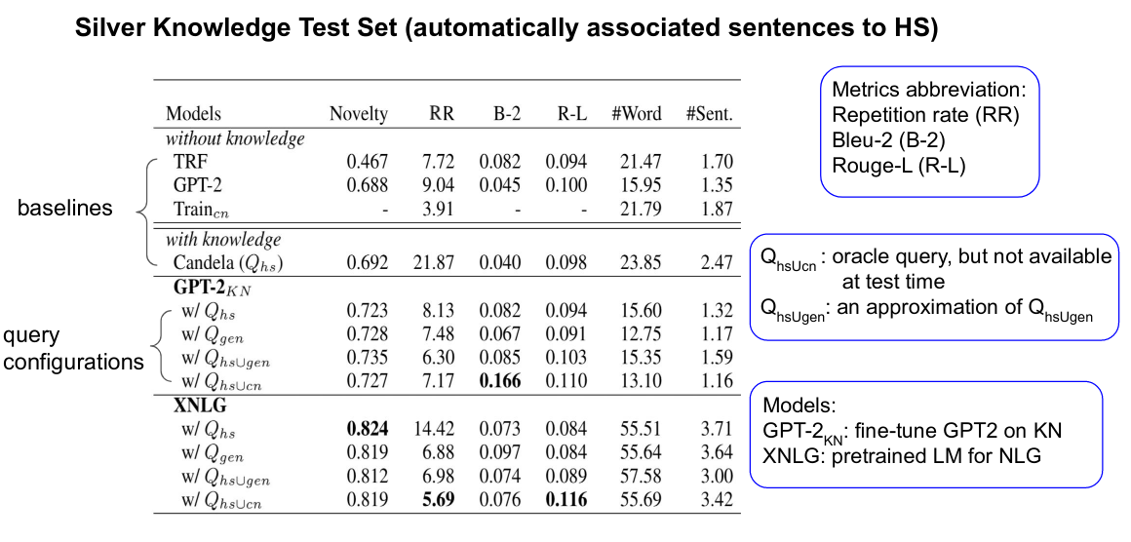
Evaluating counternarrative generation
Novelty: Jaccard similarity (Wang,2018), with respect to training data.
RR: diverse responses for the given input by repetition rate (Cettolo et al., 2014).

Slide 43
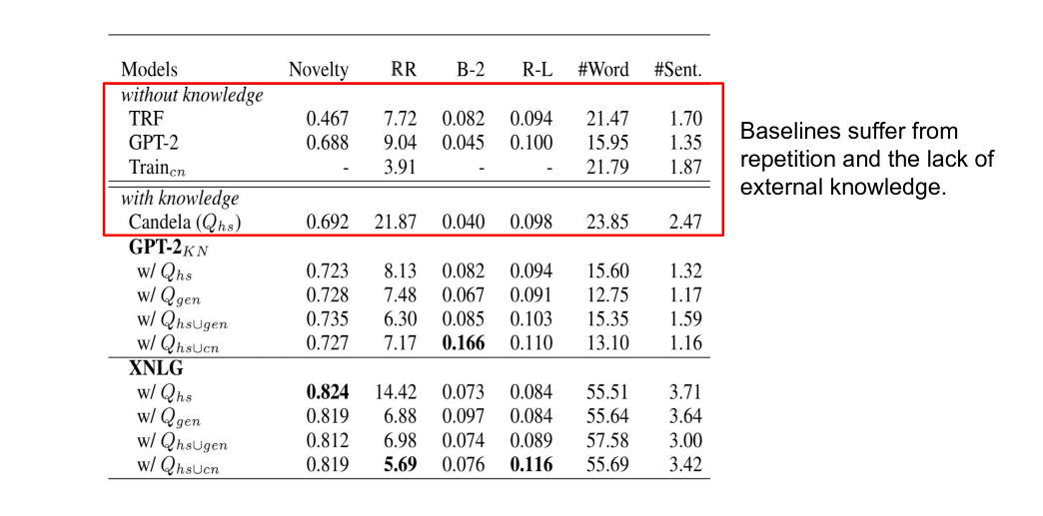
Evaluating counternarrative generation

Slide 44
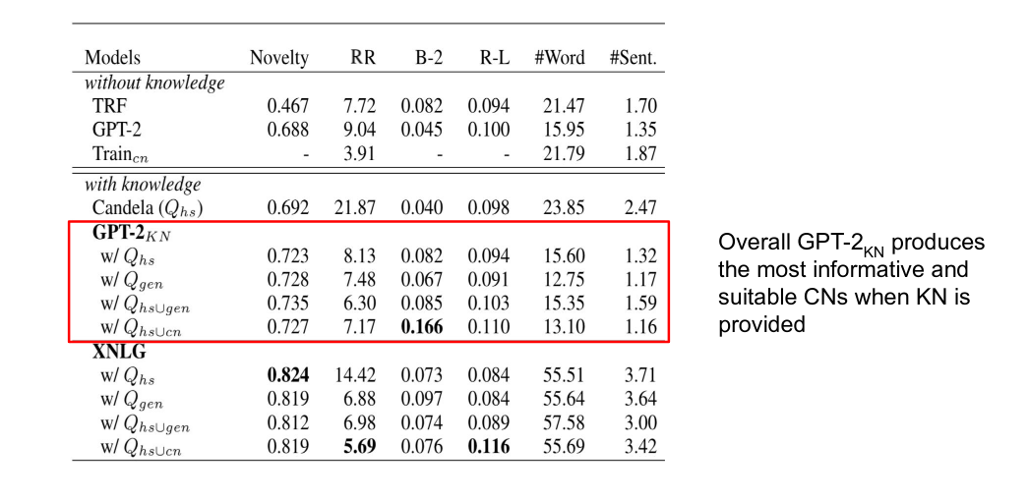
Evaluating counternarrative generation

Slide 45
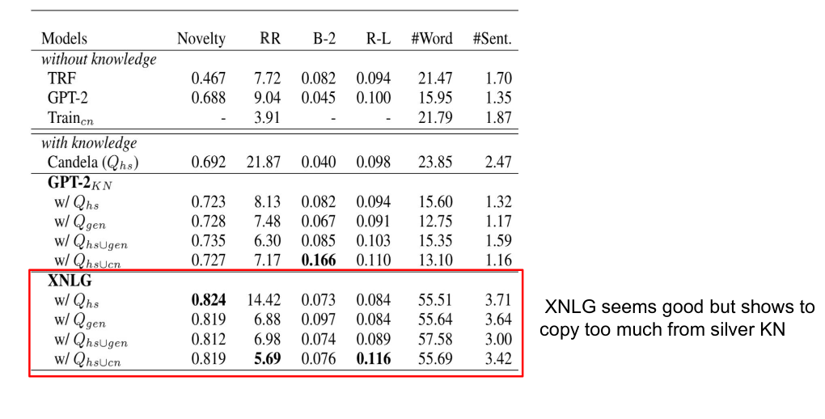
Evaluating counternarrative generation

Slide 46
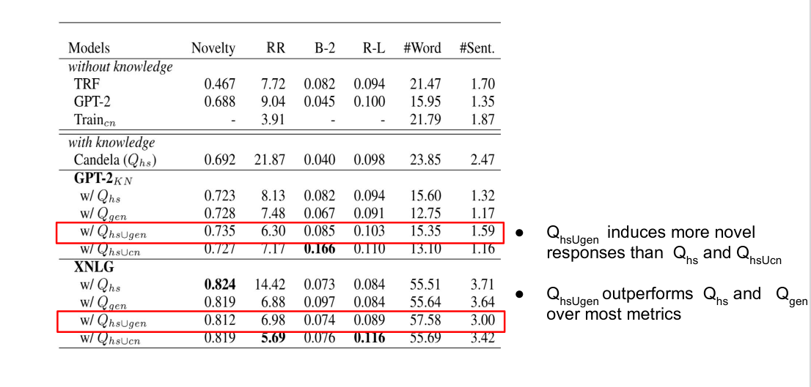
Evaluating counternarrative generation

Slide 47
Human Evaluation
3 expert operators from the NGO Stop Hate UK.
The annotators are instructed to assess all generated pairs in gold knowledge test sets in terms of
suitableness to the HS,
informativeness,
intra-coherence of CN regardless of HS.
Each score is on a scale of 1 (the least) to 5 (the most).
To avoid possible bias and hints towards models, pairs are normalized (e.g., lowercase and space between words and punctuation) and divided them into 3 partitions of randomized files.
Each expert was given 388 pairs, resulting in a total of 1164 pairs for evaluation. To avoid excessive workload annotators were allowed to complete the task over multiple sessions at their preference.

Slide 48
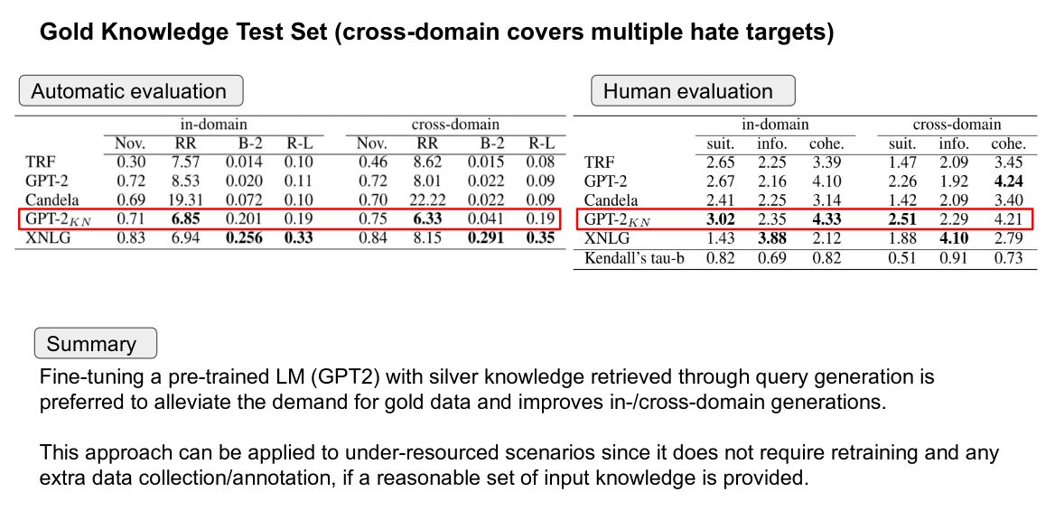
Evaluating counternarrative generation
XNLG generations as the most informative and GPT-2KN generations as the most suitable.

Slide 49
Lab Time!
[9. Finetune mT5 for Argument Generation]
Using Huggingface Transformers API
Using run_translation.py example script
[Assignments]Test the model and check the results with respect to the CONAN paper
Test the pretrained the NLG models by entering your own hate speech... (DISCLAIMER: no hate speech condoned)

